Slide 1
PSFD PRESENTATION
TEAM:-
S.J SUMANTH(2010030377)​
K.SREEVARUN(200030451)​
E. PAVAN SAI(2010030538)​
E. SHIVA GOUD(2010030542)​

Slide 2
Handwritten Digit Recognition using Python
REFERENCE: Deep Learning Project - Handwritten Digit Recognition using Python - DataFlair (data-flair.training)

Slide 3
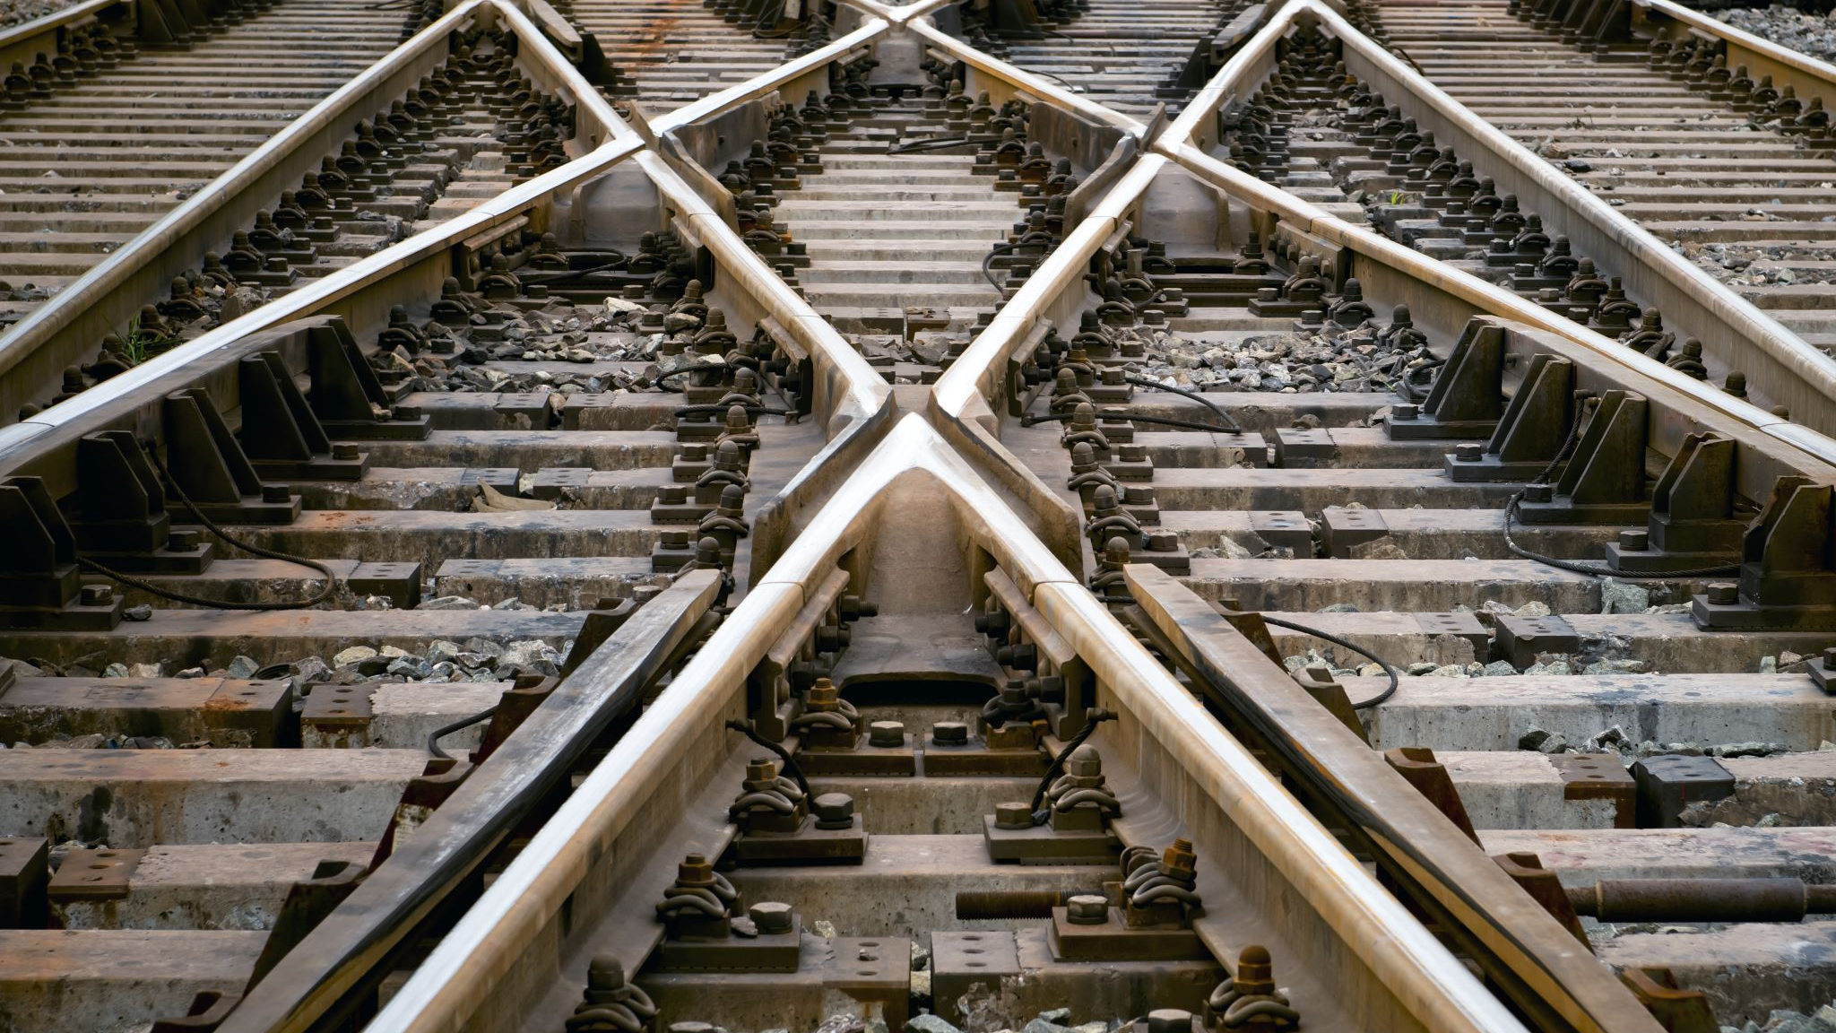
Outline
Abstract
Introduction
Literature Review
Methods
Discussion
Conclusion

Slide 4
Abstract
Optical Character Recognition (OCR) is a subfield of Image Processing which is concerned with extracting text from images or scanned documents.
An OCR system depends mainly on feature extraction, recognition and classification into appropriate labels.
In this project, we have chosen to focus on recognizing handwritten digits with at most accuracy.
The challenge in this project is to use basic Image Correlation, also known as Matrix Matching, techniques in order to maximize the accuracy of the handwritten digits.

Slide 5
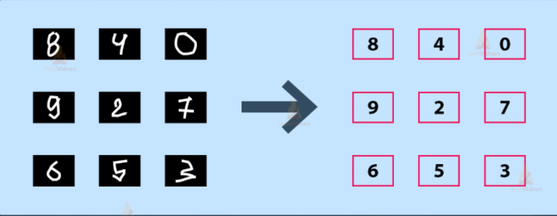
Introduction
It is easy for the human brain to process images and analyze them. When the eye sees a certain image, the brain can easily segment it and recognize its different elements. The brain automatically goes through that process, which involves not only the analysis of this images, but also the comparison of their different characteristics with what it already knows in order to be able to recognize these elements. There is a field in computer science that tries to do the same thing for machines, which is Image Processing.
Image processing is the field that concerns analyzing images to extract some useful information from them. This method takes images and converts them into a digital form readable by computers, it applies certain algorithms on them, and results in a better-quality images or with some of their characteristics that could be used in order to extract some important information from them.

Slide 6
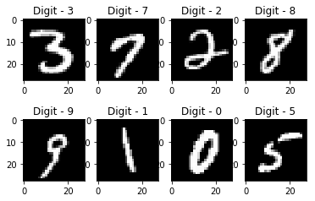
Introduction
One of the narrow fields of image processing is recognizing characters from an image, which is referred to as Optical Character Recognition (OCR). This method is about reading an image containing one or more characters or reading a scanned text of typed or handwritten characters and be able to recognize them. A lot of research has been done in this field in order to find optimal techniques with a high accuracy and correctness. The most used algorithms that proved a very high performance are machine learning algorithms like Neural Networks and Support Vector Machine.
The goal of this project is to apply and manipulate the basic image correlation techniques to build program and keep polishing and enhancing in order to investigate to which extent it can get improved.

Slide 7

Literature Review
Anuj Dutt in his paper demonstrated that utilizing Deep Learning systems, he had the capacity to get an extremely high measure of accuracy. By utilizing the convolutional Neural Network with Keras and Theano as backend, he was getting a accuracy of 98.72%. In addition, execution of CNN utilizing TensorFlow gives a stunningly better consequence of 99.70%. Despite the fact that the complication of the procedure and codes appears to be more when contrasted with typical Machine Learning algorithms yet the accuracy he got is increasingly obvious.
In a paper published by Saeed AL-Mansoori, Multilayer Perceptron (MLP) Neural Network was implemented to recognize and predict handwritten digits from 0 to 9.The proposed neural system was trained and tested on a dataset achieved from MNIST.

Slide 8
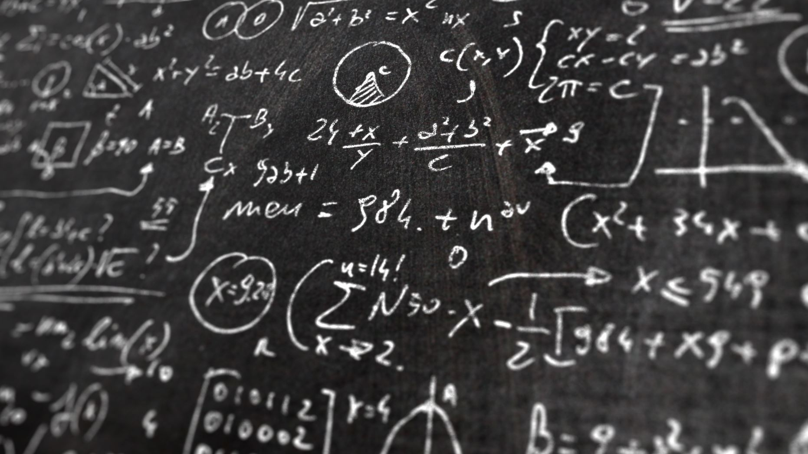
Methods
Firstly, we will train a CNN (Convolutional Neural Network) on MNIST dataset, which contains a total of 70,000 images of handwritten digits from 0-9 formatted as 28×28-pixel monochrome images.
For this, we will first split the dataset into train and test data with size 60,000 and 10,000 respectively.
Then, we will preprocess the input data by reshaping the image and scaling the pixel values between 0 and 1.
After that we will train our model.
Next, we will build an interactive window to draw digits on canvas.
Our model will process the image to identify the digit and return a series of 10 numbers corresponding to the ten digits with an activation on the index of the proposed digit.

Slide 9
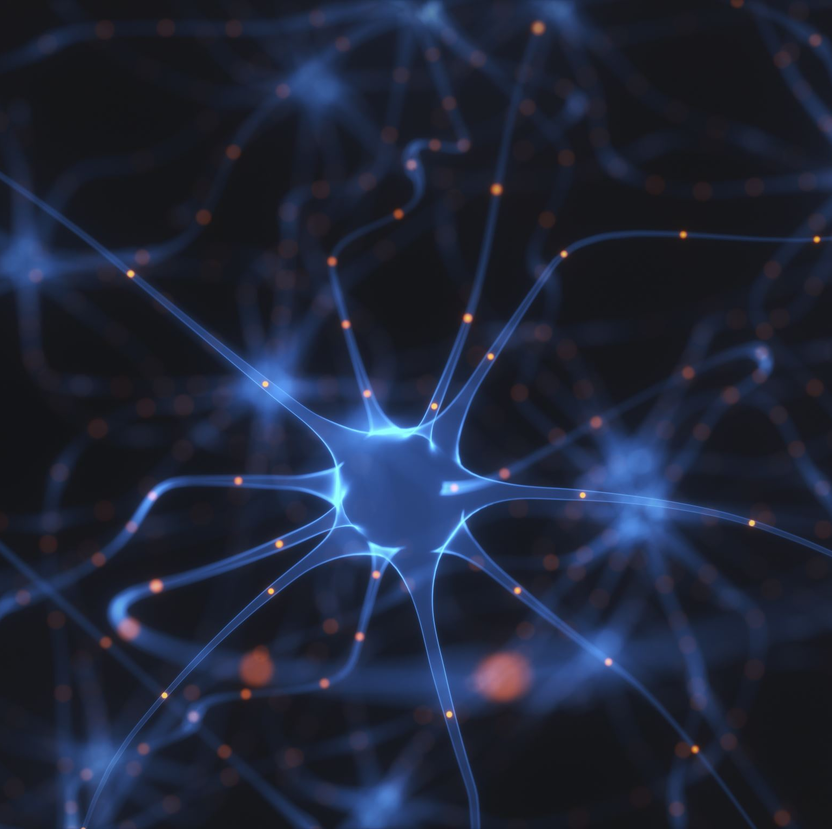
Algorithm: Convolutional Neural Networks
A Convolutional Neural Network
(ConvNet/CNN) is a Deep Learning algorithm which can take in an input image, assign importance (learnable weights and biases) to various aspects/objects in the image and be able to differentiate one from the other.
CNN utilizes spatial correlations which exist with the input data. Each concurrent layer of the neural network connects some input neurons.
This region is called a local receptive field. The local receptive field focuses on hidden neurons.
The hidden neuron processes the input data inside the mentioned field, not realizing the changes outside the specific boundary.

Slide 10
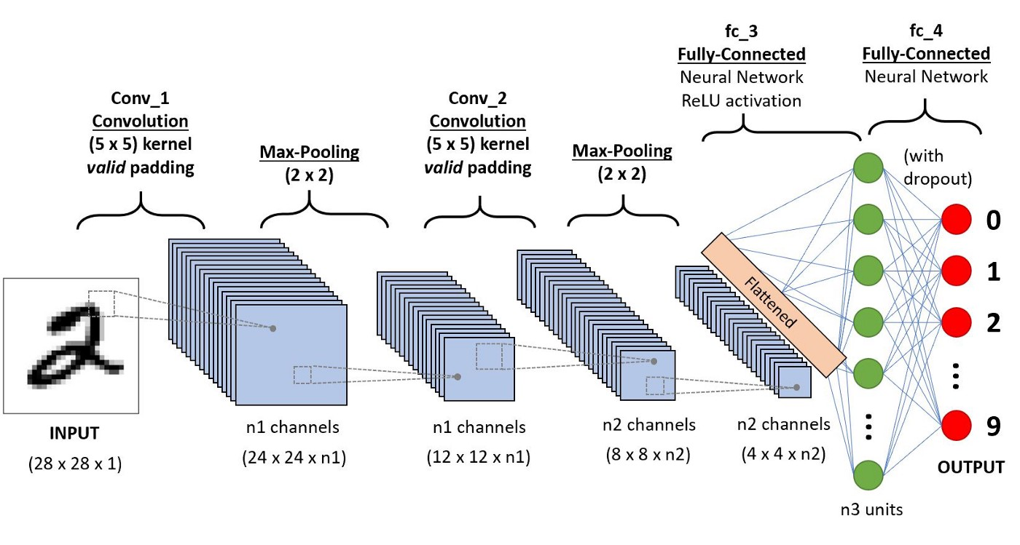

Slide 11
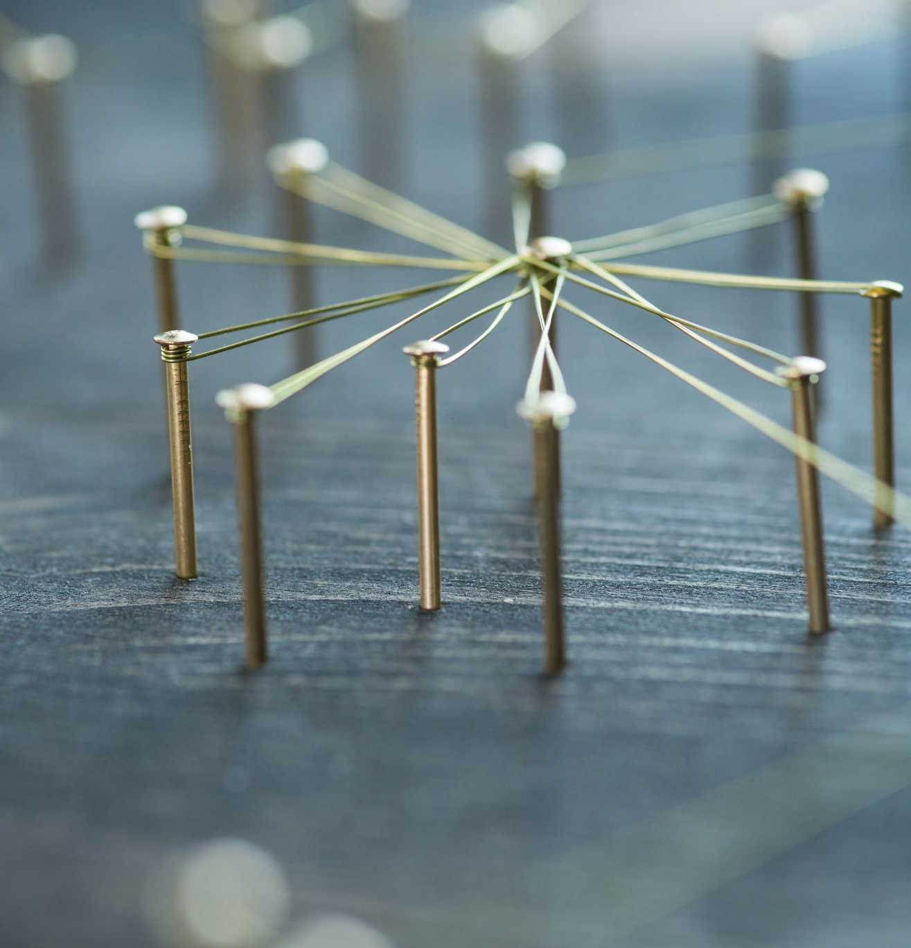
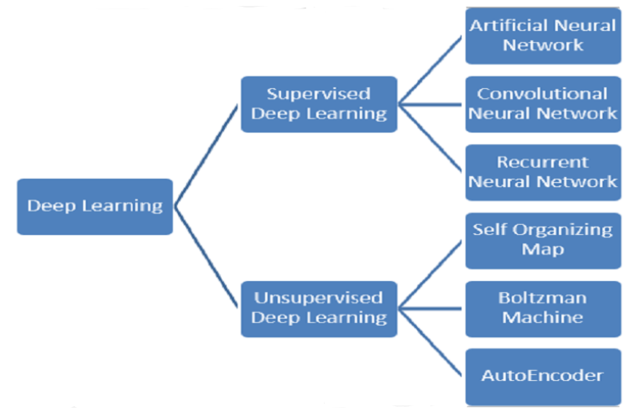
Discussion :
For the implementation of our project we discussed about Deep Learning concepts.
Mainly we can categorize Deep learning into two types and then we further drill down each type into various deep learning algorithms.

Slide 12
Discussion :
We discussed supervised deep learning concepts.
1. Artificial Neural Network
An artificial Neural Network is the component of a computing system designed in such a way that the human brain analyzes and makes a decision. ANN is the building block of deep learning and solves the problem that seems impossible or very difficult by humans.
2. Convolutional Neural Network
CNN is a supervised type of Deep learning, most preferable used in image recognition and computer vision. CNN has multiple layers that process and extract important features from the image.
3. Recurrent Neural Networks (RNNs)
RNN is a type of supervised deep learning where the output from the previous step is fed as input to the current step. RNN deep learning algorithm is best suited for sequential data. RNN is most preferably used in image captioning, time-series analysis, natural-language processing, handwriting recognition, and machine translation.
From the above concepts we have chosen Convolutional Neural Network which meets the requirements of our Project Implementation.

Slide 13

Conclusion:
Several OCR systems were studied and accurate methods, techniques were analyzed. OCR is a challenging area of research and introduces new challenges with its changing dynamics.
The most widely used Machine learning algorithm i.e CNN will be trained and tested on the same dataset in order acquire the comparison between the classifiers. Utilizing these deep learning techniques, a high amount of accuracy can be obtained

Slide 14


